Slide 1
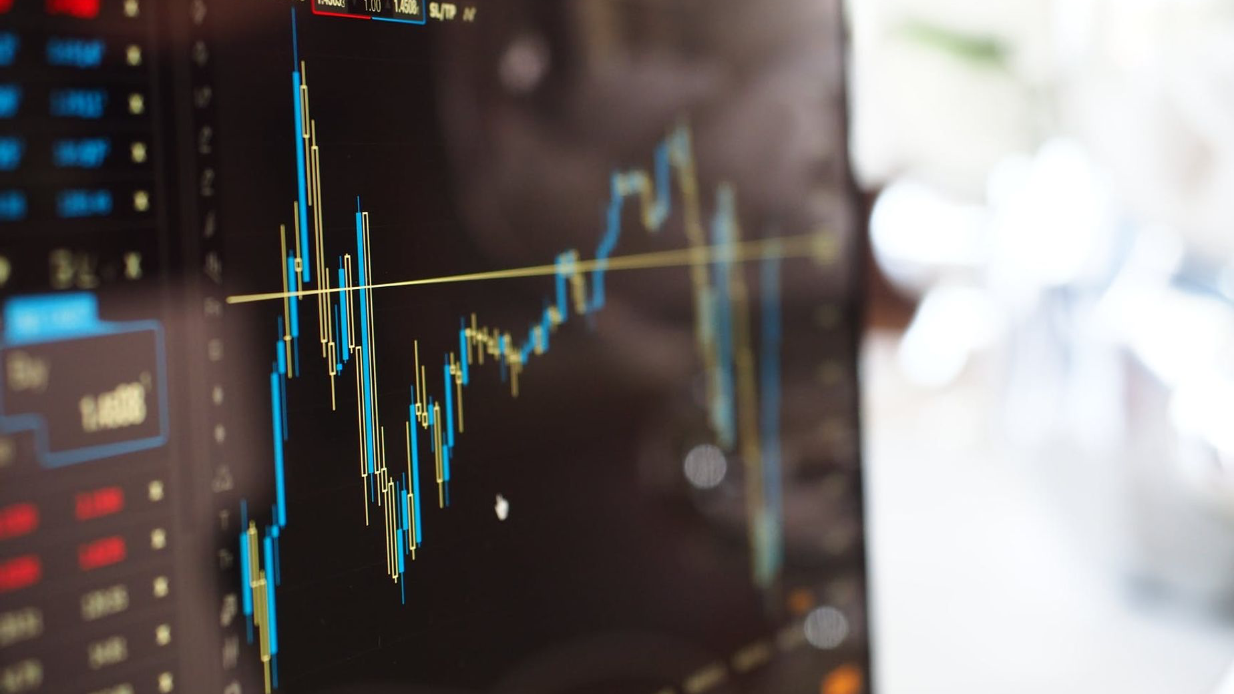
Analyzing the FAANG Stocks: Correlation between Price and Volume with Economic Changes

Slide 2








Team Excelsior
Ariel Richardson
Ashley Blackmon
Kara Simone
Colton Short
Saeeda Panjwani
Steve Kennedy
Luis Aguayo
Marlon Ruiz
4

Slide 3

FAANG Stocks Overview
The FAANG stocks are a group of five technology stocks that have been some of the most visible investments in recent years. These stocks include Facebook, Amazon, Apple, Netflix, and Google.
3

Slide 4
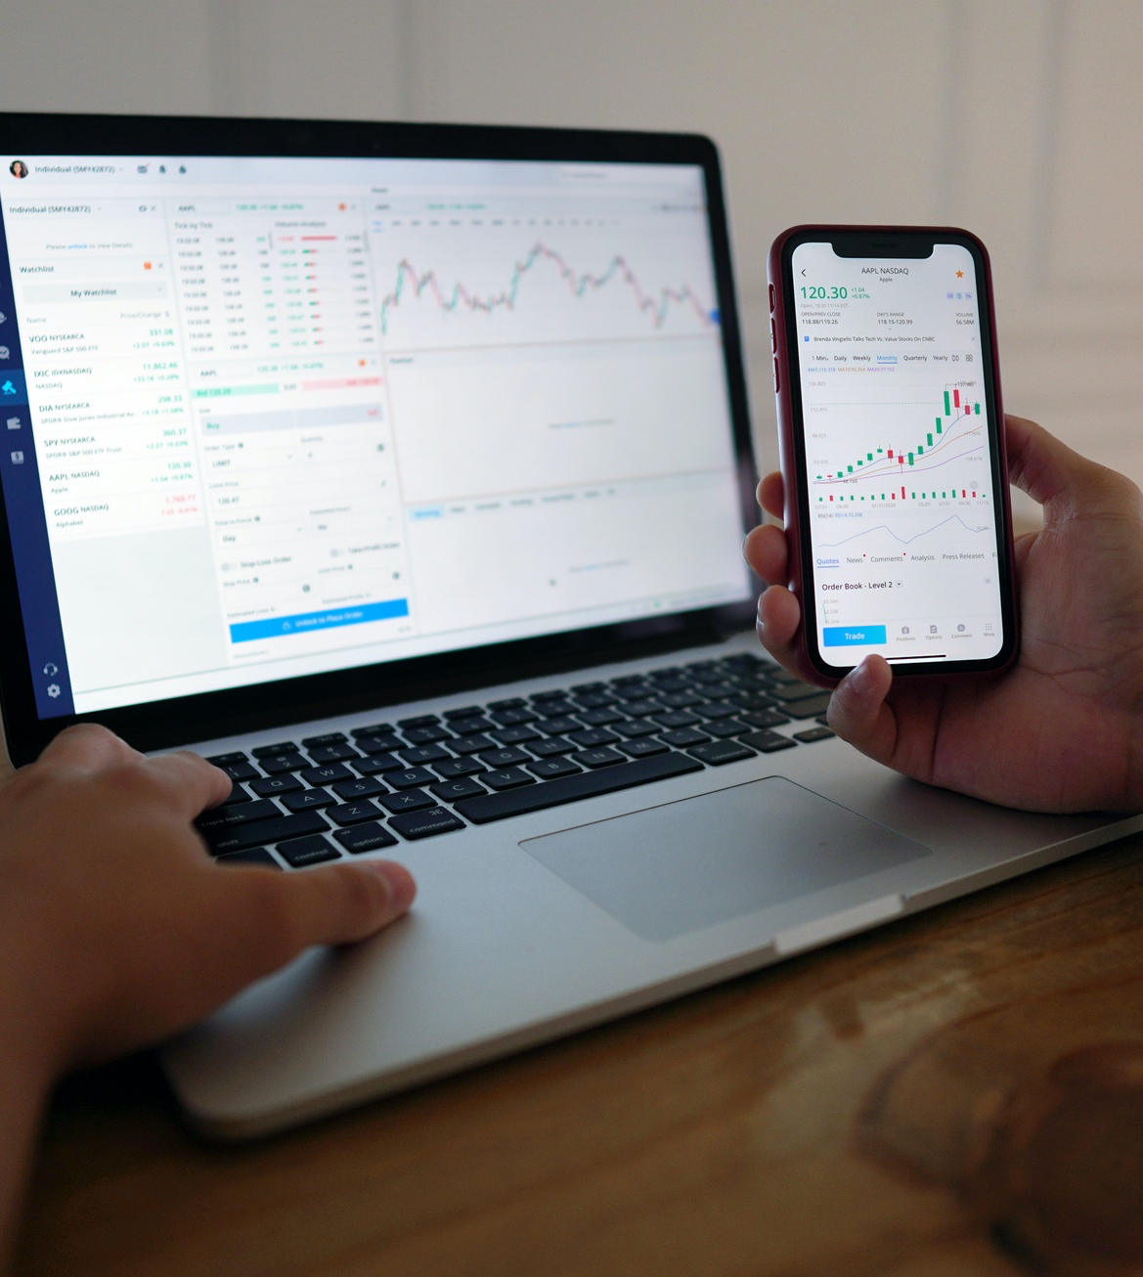
Global Impact of FAANG Stocks
The FAANG stocks have had an impact on the global economy. Their prices and trading volumes do not correlate with economic markers we chose to use in this project.
4

Slide 5




Answering the Four Questions using Nasdaq API
What is the relationship between stock prices and time?
How does Treasury interest rate changes affect stock prices during 2022?
How does the inflation rate correlate with stock trading volume during 2022?
Which stock appear to be the best investment insofar as performance?
By utilizing the Nasdaq API, our team was able to answer the questions above

Slide 6



Analyzing Data with the NASDAQ API: Our Summary and Challenges
Overview of the process
Data analysis
Conclusion

Slide 7
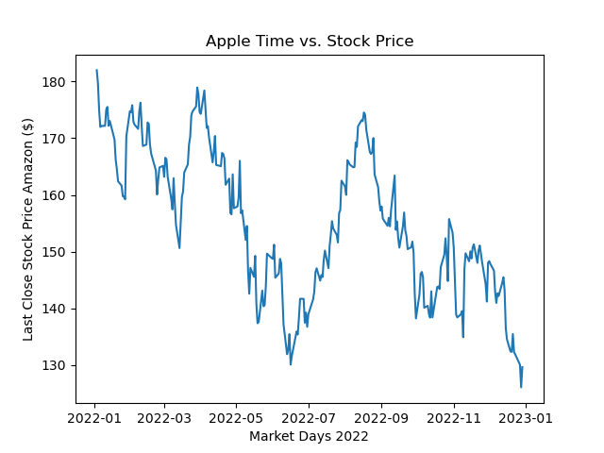
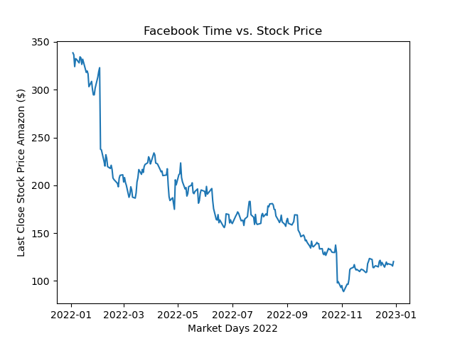
Highest and Lowest Performing Stocks

Slide 8
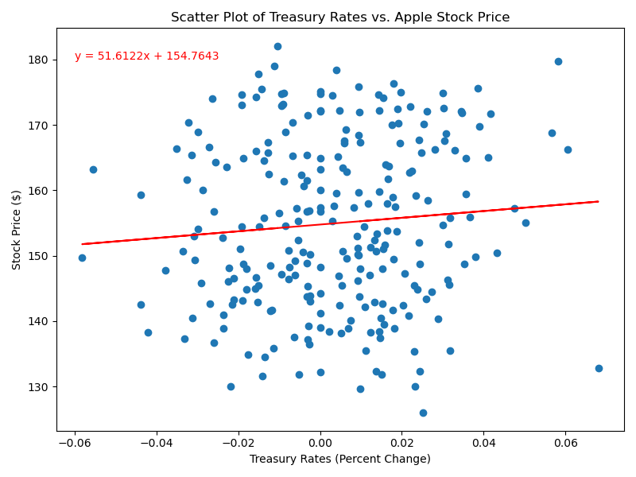
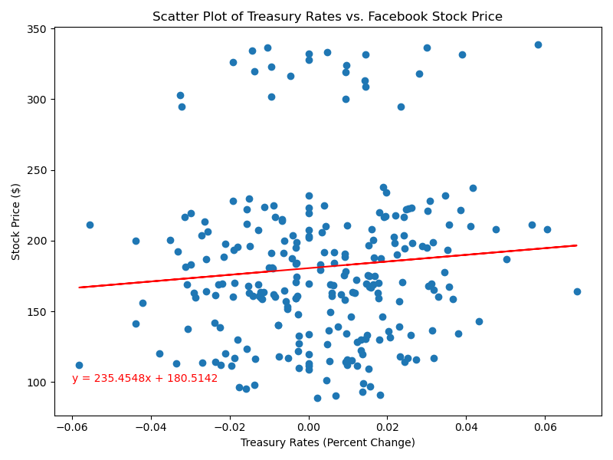
Treasury Interest Rate Changes
R-Value =0.086
R-Value = 0.089

Slide 9
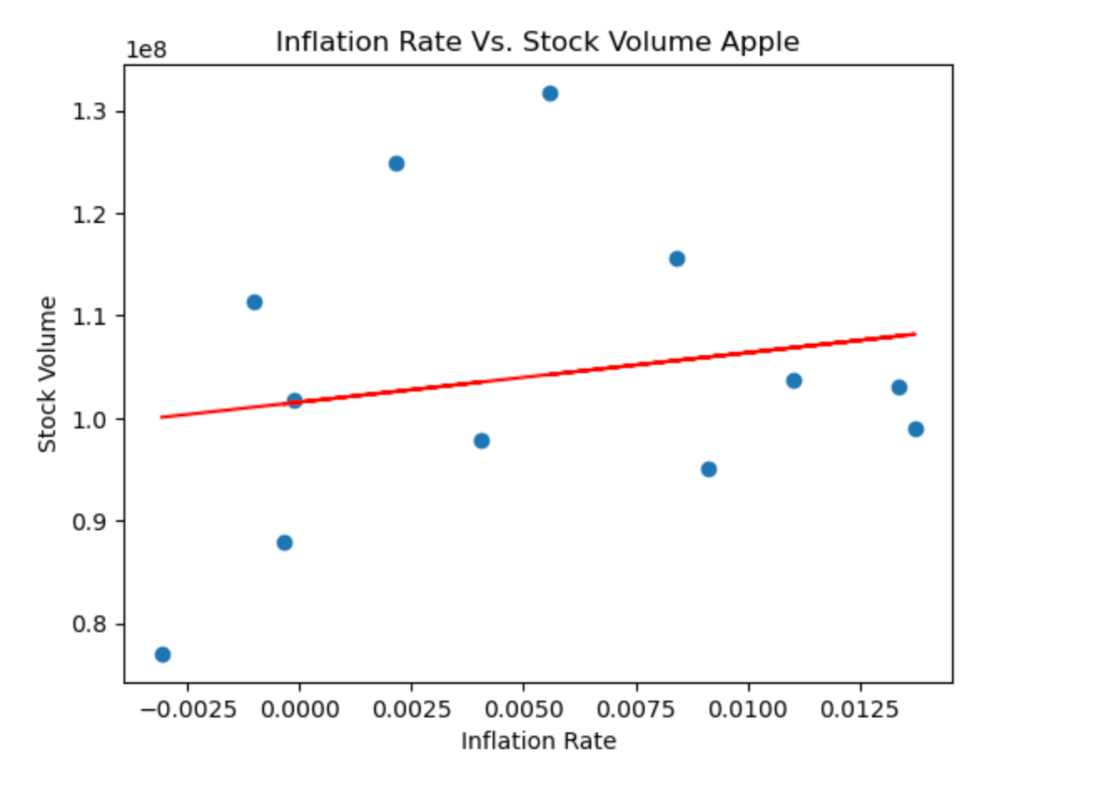
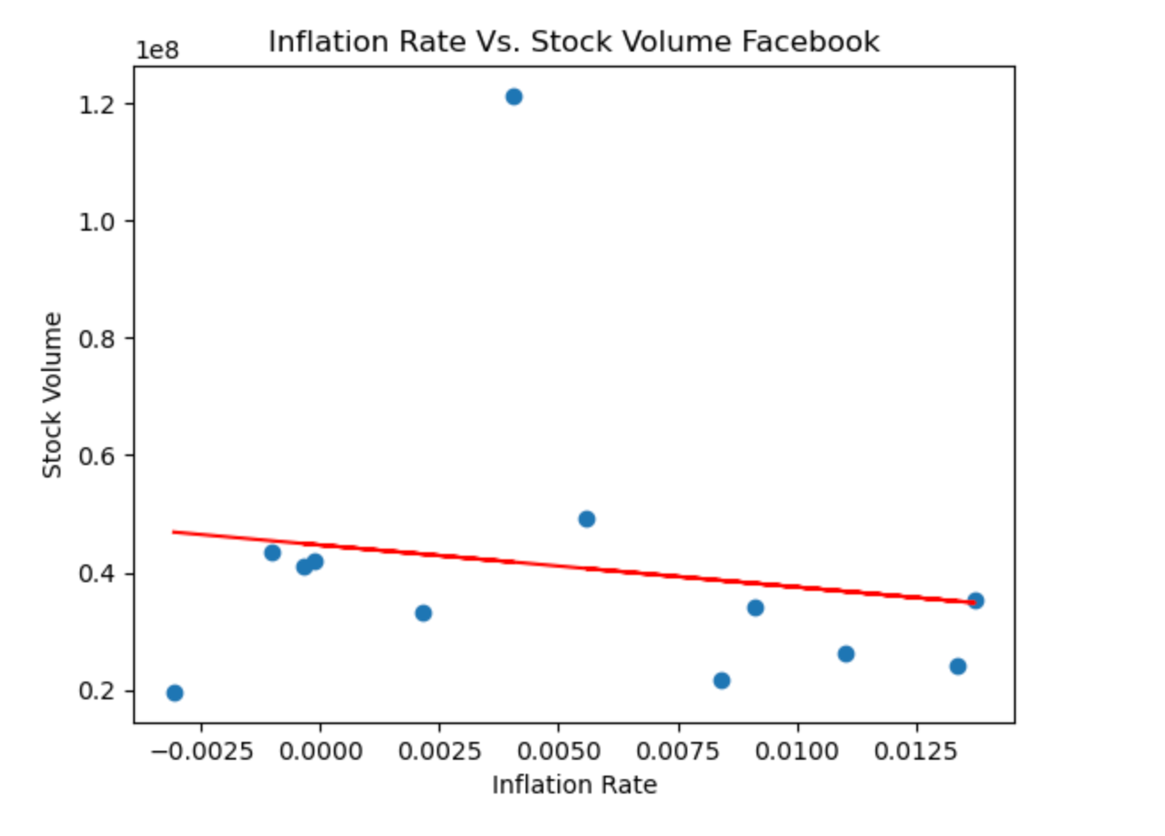
Inflation Rate Correlate to Stock Volume
R-Value = 0.035
R-Value = 0.024

Slide 10
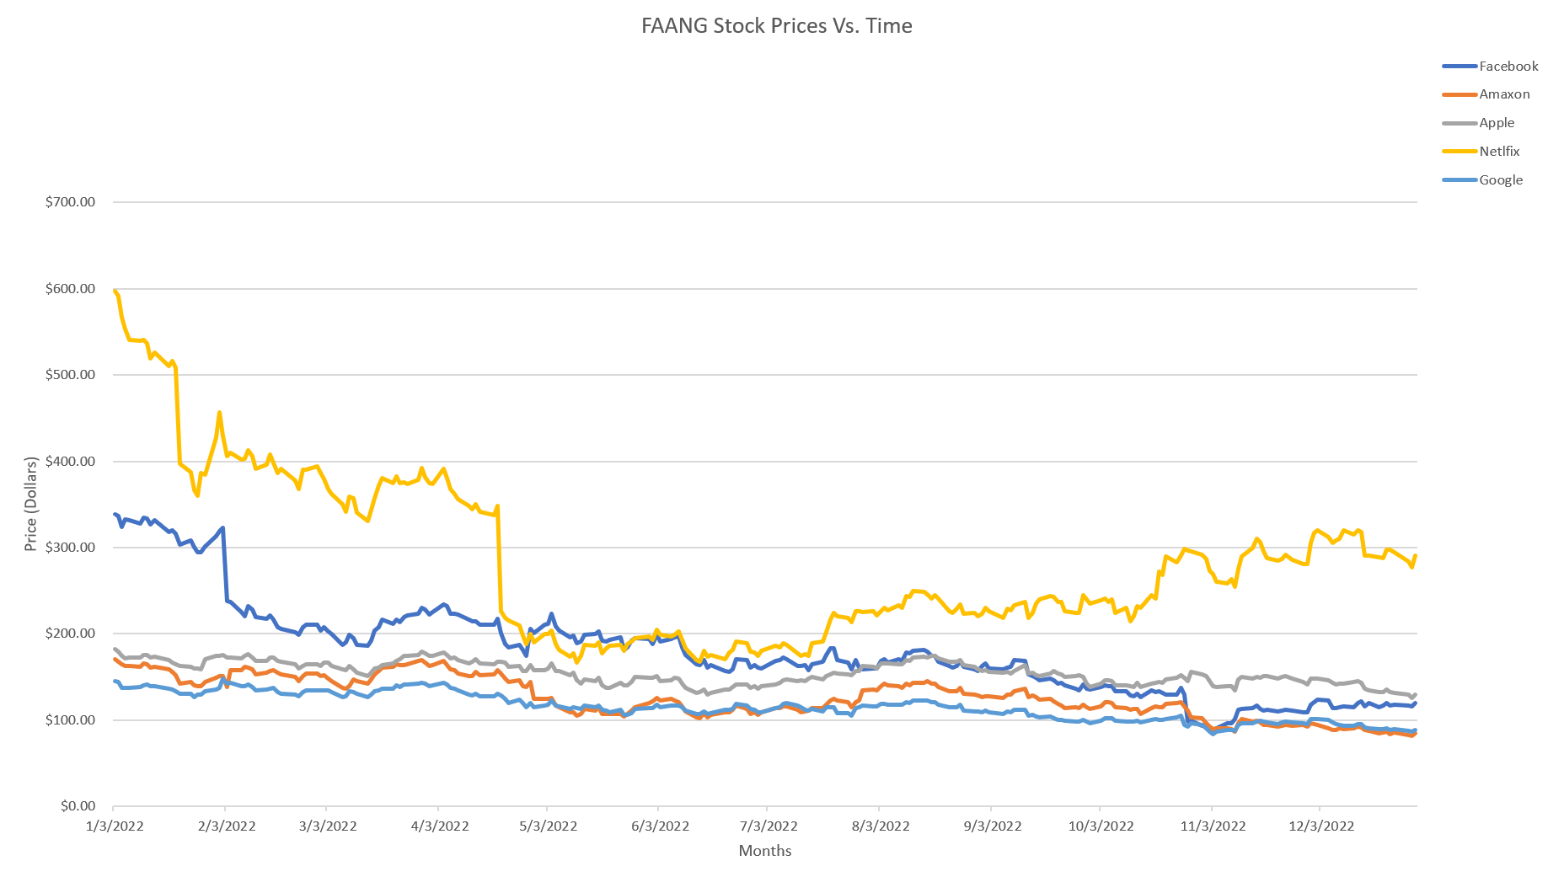
Best Stock Based on Performance

Slide 11
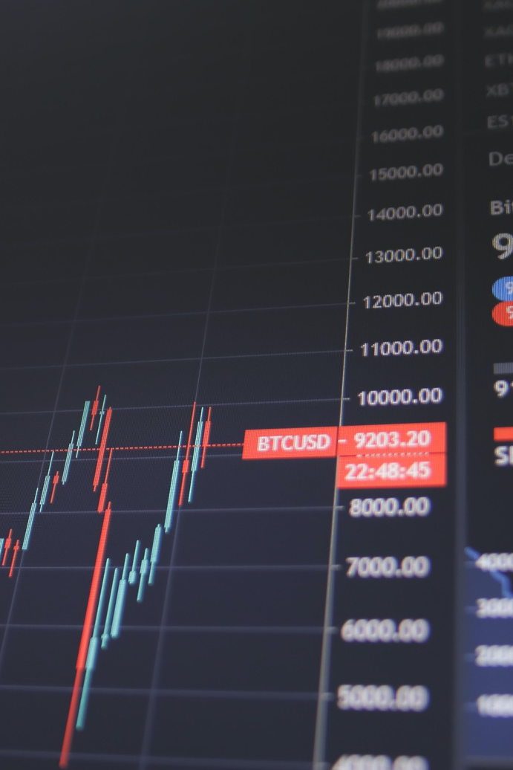
In Conclusion
In FAANG Stocks, interest rate changes do not correlate to the stock prices
Inflation rates did not have correlation to the volume of stocks purchased
Based on our research Apple was the best performing stock
11

